Slide 1

MX Linux

Slide 2
MX Linux
A cooperative venture between antiX and Mepis communities
Middle weight operating system
Based on Debian 9.6 Stretch
Xfce desktop
First released 25 March 2014

Slide 3
MX Linux Minumum Install Requirements
Modern amd or Intel i486 processor (modern amd or Intel i686 processor recommended)
512 Mb RAM (2 Gb RAM recommended)

Slide 4
MX Linux Ease of Installation
The one install was completed in 15 minutes (however it was done to an SSD)
No hangups noted during installation.

Slide 5
MX Linux Resources
MX Linux forums
Install/user manual

Slide 6
MX Linux Ease of Navigation
All configuration applications are located together to make changing things easier.
The xfce desktop allows for finding applications very easy

Slide 7
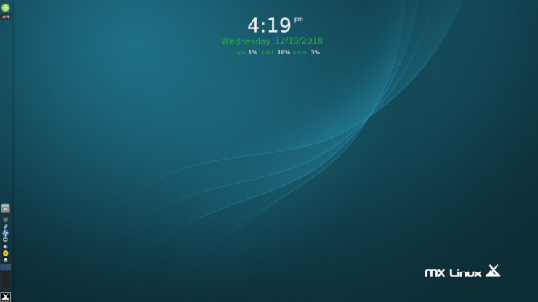
MX Linux Desktop

